Slide 1

Scored! Maximizing Chances of Victory in Basketball
Annan (Aruba) Chen
Guo Guo (Vannie) Hong
Ziyi (Laura) Ma
Notes:
Like most people in this room, I don’t play basketball, and I don’t care about winning basketball games.
When is the last time you went to an entertainment park, or a night market and spent $5 on a ring toss game? You kept thinking to yourself how you can win that $5 back, but failing to do so. The top basketball players in the world face the same dilemma. Our project, done by Aruba, myself and Laura, helps them maximize all stakeholders’ chances of victory.

Slide 2
Agenda
Introduction
Data Understanding & Preparation
Exploratory Data Analysis
Modeling, Results & Evaluation
Recommendations, Challenges & Mitigations
Notes:
Laura will first show you how our EDA is conducted. Aruba will then show you our modeling methodologies and our results. I will close off with our recommendations.

Slide 3

1.1 Background and Business Problem
National Basketball Association (NBA)
Premier basketball league, based in North America
Total of 30 teams
NBA players are the world’s best paid athletes
But, who truly are the best shooters and defenders? How do they maximize their chances of scoring?
Notes:
NBA stands for national basketball association and is a premier basketball league based in North America. There are 30 teams, 29 in the U.S. and 1 in Canada. NBA players are the world’s best paid athletes by average annual salary player. Most NBA players have a rate of xx...thus naturally, they should be scoring every time, which isn’t the reality. How do they maximize their chances of scoring? Who are the best shooters and defenders?

Slide 4
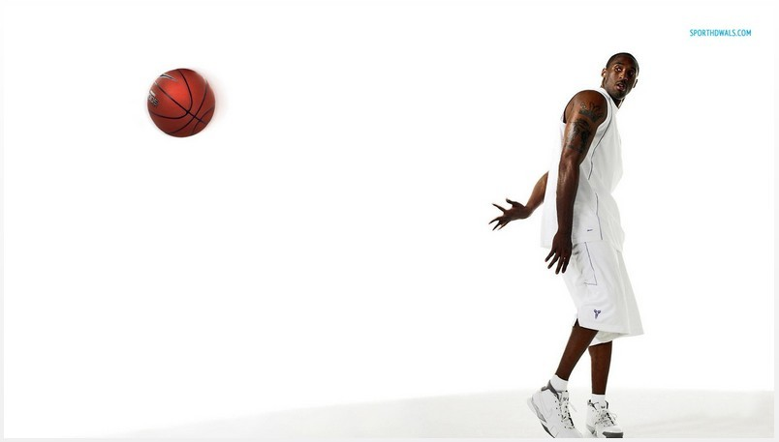
1.2 Project Objective:
Build a shot prediction model, whether the player will score or not score, based on the shots and circumstances under which they are made.
Notes:
Our objective is to build a shot prediction mode, whether the player will score or not score, based on the data analysis that we conduct after taking the shots and the circumstances under which they are made into consideration.

Slide 5
1.3 Stakeholder and Potential Benefits
Stakeholders:
Basketball management groups
Basketball coaches
Basketball players
Basketball fans
Basketball game designers/players
Potential Benefits:
Evaluate offence and defence strategies
Identify the best players and their assets
Develop more realistic game simulations
Notes:
The people that will care are the basketball management groups, coaches, the players themselves, the fans, and the game designers/players that will try to simulate this in their products. Having this prediction model can better evaluate the offence and defence strategies, identify the best players, and develop more realistic simulations in business products.

Slide 6

2. Data Understanding & Preparation

Slide 7
2.1 Understanding Our Data:
Public Kaggle dataset
All shots attempted during the 2014-2015 NBA season
Target variable: “Shot_Result”
127,951 observations
53 variables
Notes:
We found a Kaggle dataset that records all shots attempted during the 2014 to 2015 NBA season. B/c this original dataset lacked xx information, we cleansed and blended data from other sources (explain this step in more detail). There are now a total of x predictor variables, and a total of 127,951 observations. The target variable that we will assess is the “Shot_Result”, whether the shot was successful or not.

Slide 8

2.1 Data Preparation
Gathered player data
Deleted unnecessary information
Renamed predictor variable fields
Combined seasonal data and player data
Took out 70 variables
Notes:
We first collected data of our NBA players from another source. We then cleaned our data through deleting some variables (offence variables in defenders and defend variables in offenders). Data formatting is then done to match the right fields. Data blending is then conducted to combine seasonal data and player data. Data sampling...

Slide 9

3. Exploratory Data Analysis

Slide 10
3. 1 Methods Employed
We used:
Box plot
Violin plot
Distribution plot
Bar plot
Facet grid
Tableau

Slide 11
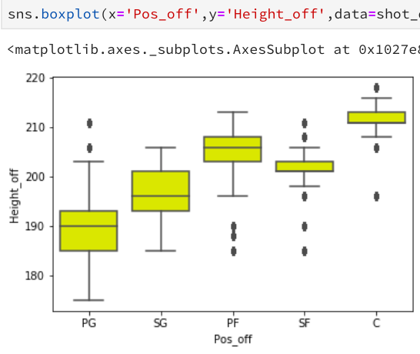
3.2 Box Plot
Observation:
C (Center): Highest height average: last defense line
PG (point guard): lowest height average: control the ball
PG: Point Guard
SG: Shooting Guard
PF: Power Forward
SF: Small Forward
C: Center
Notes:
First, we plotted the box plot to visualize the difference in height of different players. We see five positions here: they each have different responsibilities. If you don’t know what each of these position does, it;s ok. Let’s just look at the position with the highest height: center, who are generally the tallest and they need to block defenders for other team mates to shoot the goal
For Point guard they usually need really good ball handling skills and are essential to initiate offence. So they tend to be the shortest and most agile in the players.

Slide 12
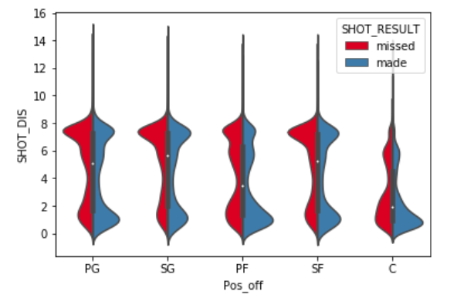
3.3 Violin Plot
Observation:
Shot distance converge on two extremes: whether close or far (whether close to the basket, or 3 points)
Notes:
Next, we did violin plots from which we can see where most of the shots were fired. There is an clearly observable pattern here: shots are concentrated in either very close to the basket, or far away from the basket (the 3 point goals). Almost no shots of medium distance was made. This make intuitive sense because half a step back you can score a 3 point or you can go nearer and your chances of scoring goes higher. That’s why they concerge on two extremes. For center positions because they usually stay under the basket to defend or ward off defenders, if they have a chance to socre, it is usally close to the basket.

Slide 13
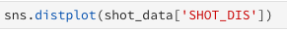
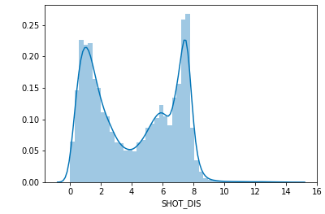
3.4 Distribution Plot
Observation:
Shot distance converge on two extremes
Notes:
Similarly, this distribution plot is basically tells us the similar thing. Now it’s just more obvious. Most of the shots were made just outside the 3 point line of 7.24 m

Slide 14
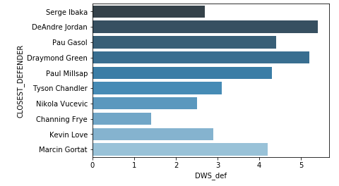
3.5 Bar Plot
Observation:
Which defender is the best in this season
i.e. most effective when faced with an offence
Notes:
Here is a bar plot we drew, which measure each closest defender’s defensive win share

Slide 15
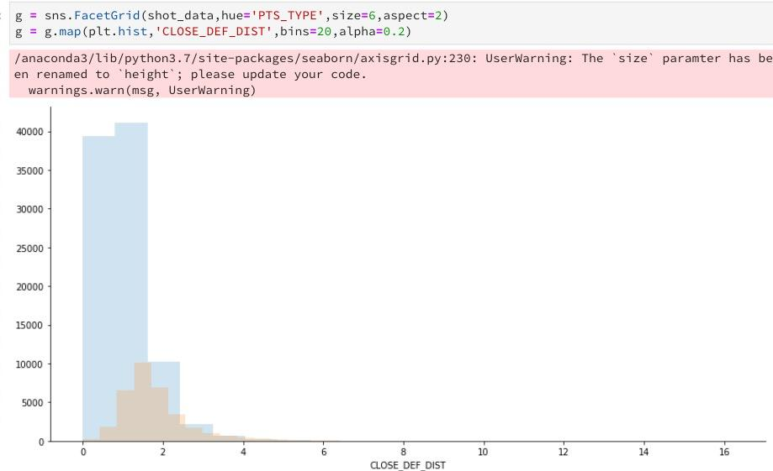
3.6 Facet Grid
Observation:
More 2-point shots
Defenders for 2-point goals are usually closer
Notes:
In the facet grid here, we were able to plot three-point and two-point goals together. You can see the blue grids that represent two-points, it is shot a lot more often than 3-point goals. You can also see from closest defenders distance that defenders for 2-point goals are usually closer. This again makes intuitive sense.

Slide 16
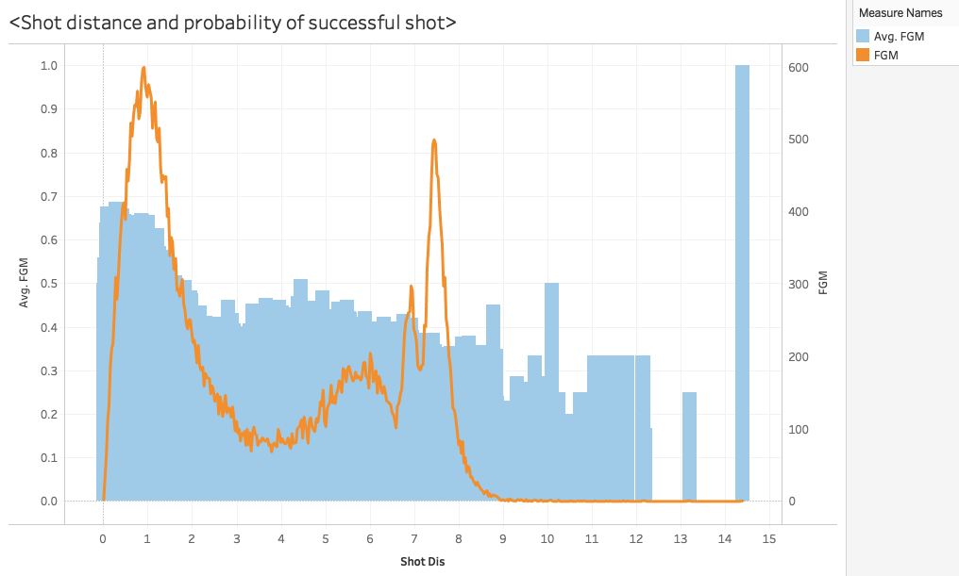
3.7 Tableau
Observation:
More Field Goal Made in certain shot distance
Some outliers like a shot made 14.4 meters from the basket (John Wall)
Notes:
Next we plotted the maximum of shot distance and defender’s distance. We can see clearly that when the shot is missed, the closest defenders are generally closer, even for maximum distance while the successful

Slide 17
4. Modeling & Evaluation
Methods: Logistics Regression & Decision Tree

Slide 18
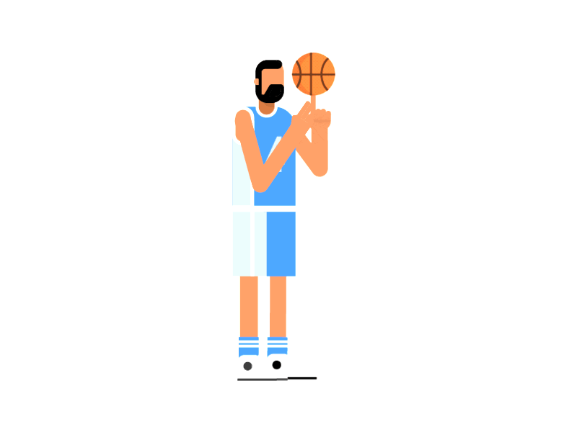
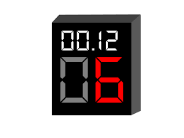
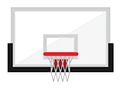
4.1 Variable Selection
Player Data:
Age? Height?
Past Performance?
Shooting Status:
Remaining Time?
Distance?

Slide 19

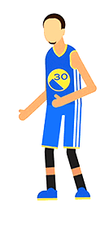
4.1 Variable Selection
Player Data
Defender Data
Age? Height?
Handsome?
Shooting Status
“YOU CAN’T GUARD ME”
Distance?
Notes:
So if we consider the defender’s data, we need to also include the defender’s age, and height etc, and we induce another distance that is the distance between player and defender. As you can imagine intuitively, closer the defender is, harder for you to make the shot.

Slide 20
4.1 Variable Selection
Player’s Variables
Age
Height
Offense Win Share
Usage%
Turnover%
Field Goal%
Offense Box Plus/Minus
Touching Time
Dribbles
Defender’s Variables
Age
Height
Defence Win Share
Usage%
Turnover%
Total Rebound%
Stealing%
Defence Box Plus/Minus
Personal Fouls
Distance to Player
Status
Home/Away
Period (1-4)
Shot Clock
Shot Distance
Notes:
These are the variables we choose to run data analysis. We try to select as many variables as possible in the first run to not miss any relevant factor. But we also ignore some variables that we perceived to be unimportant, for example, we do not consider whether the defender is a good shooter or not, but we focus on the defensive data like stealing, rebound and blocking.

Slide 21
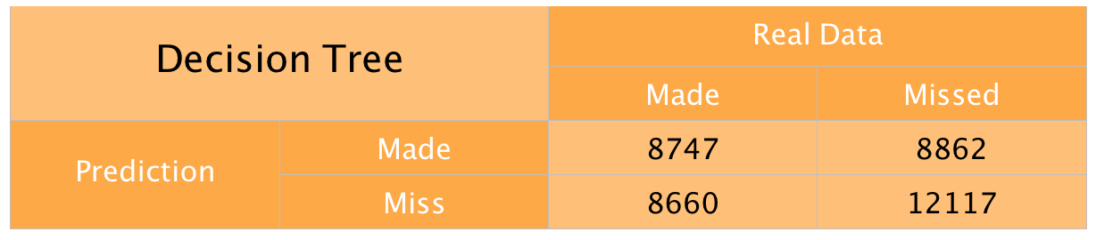
4.2 Decision Tree and Random Forest
Dependent Variable: SHOT Result ( 0 = miss, 1 = made)
Accuracy: 0.5435
Precision: 0.4967
Recall: 0.5025
F1-score: 0.4996
Test(30%)
Train(70%)
38386 Obs
89565 Obs
Notes:
Accuracy: 0.5435314958578649
Precision: 0.49673462433982624
Recall: 0.5024989946573217
F1-score: 0.49960018277358914

Slide 22
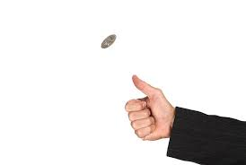
4.2 Decision Tree and Random Forest
Dependent Variable: SHOT Result ( 0 = miss, 1 = made)
Accuracy: 0.5435
Precision: 0.4967
Recall: 0.5025
F1-score: 0.4996
Probability of Coin
Flipping: 0.5
Notes:
Accuracy: 0.5435314958578649
Precision: 0.49673462433982624
Recall: 0.5024989946573217
F1-score: 0.49960018277358914

Slide 23

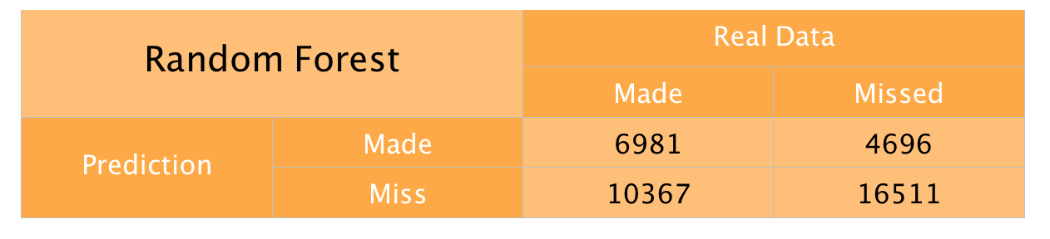
4.2 Decision Tree and Random Forest
Number of Trees: 300
Accuracy: 0.6199
Precision: 0.6097
Recall: 0.4010
F1-score: 0.4839
How do we know each variable’s marginal effect ?
Notes:
confusion matrix: [[16511 4468] [10426 6981]] ______________________________________________ Model: Random Forest Accuracy: 0.611993956129839 Precision: 0.6097475762075291 Recall: 0.4010455563853622 F1-score: 0.48385084557804264

Slide 24
4.3 Logistic Regression
Dependent Variable: SHOT Result ( 0 = miss, 1 = made)
Independent Variables:
Test(30%)
Train(70%)
38386 Obs
89565 Obs

Slide 25
4.3 Logistic Regression
Shot-related Variable:
VARIABLE | COEF | P-VALUE
CONSTANT | 0.5310 | 0.078
HOME | 0.0303 | 0.029
PERIOD | -0.0004 | 0.943
SHOT_CLOCK | 0.0154 | 0.000
SHOT_DIS | -0.2149 | 0.000
“Home, sweet home”
“Time helps me relax”
“Further, harder”

Slide 26
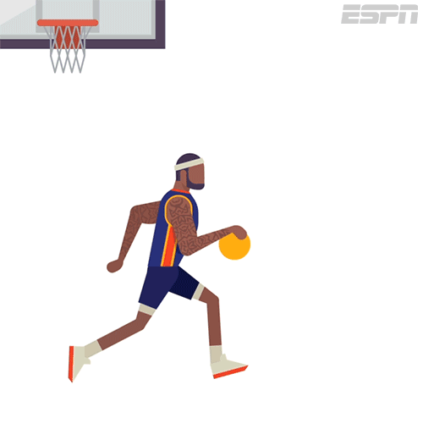
4.3 Logistic Regression
VARIABLE | COEF | P-VALUE
TOUCH_TIME | -0.0816 | 0.000
DRIBBLES | 0.0441 | 0.000
Height_off | -0.0015 | 0.104
Age_off | 0.0064 | 0.000
OWS_off | -0.0016 | 0.800
OBPM_off | 0.0272 | 0.000
FG%_off | 1.4884 | 0.000
USG%_off | 0.0027 | 0.105
TOV%_off | -0.0052 | 0.018
Offense-related Variables:
“Experience does help”
“I am good at shooting”
“Be careful”

Slide 27
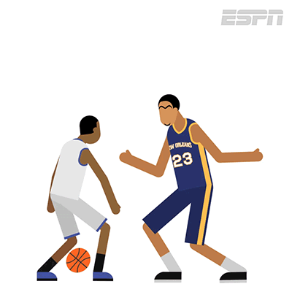
4.3 Logistic Regression
VARIABLE | COEF | P-VALUE
Height_def | -0.0033 | 0.004
Age_def | -0.0033 | 0.038
DWS_def | -0.0231 | 0.003
BLK%_def | -0.00485 | 0.000
TRB%_def | -0.0034 | 0.170
STL%_def | -0.0019 | 0.887
USG%_def | 0.0004 | 0.782
TOV%_DEF | -0.0011 | 0.579
CLOSE_DEF_DIST | 0.3886 | 0.000
Defence-related Variables:
“ Hey! Come closer. ”
“I am taller than you”
“Experience still works”
“Block!”
Notes:
Results of defence related variables

Slide 28
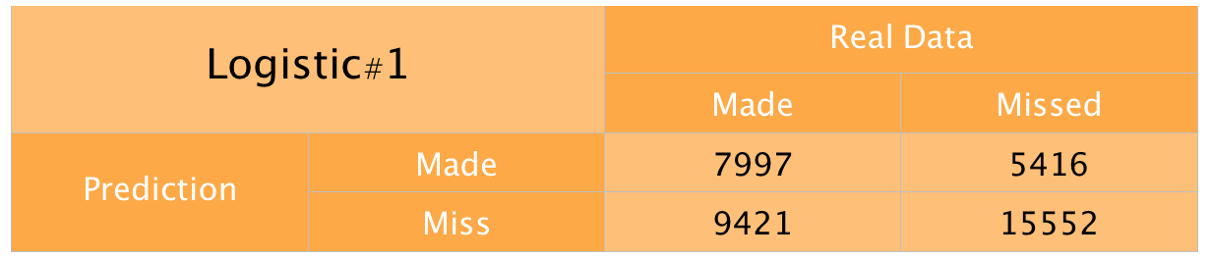
4.3 Logistic Regression
Logistic#1
Accuracy: 0.6135
Precision: 0.5962
Recall: 0.4591
F1-score: 0.5188
Random Forest
Accuracy: 0.6199
Precision: 0.6097
Recall: 0.4010
F1-score: 0.4839
Notes:
We can already get the a little bit of insight from the result in this first regression.
The accuracy of logistic regression is very close to the random forest, but the F1-score has improved relatively more.
So if we compare this two model only, the logistic regression is probably the one we want.
However, if we go back to see the coefficients we have. There might be some problems. First, there are too many variables. Second, several variables have p-value larger than 0.05, which means there are not significantly different from zero.
confusion matrix: [[15552 5416] [ 9421 7997]] ______________________________________________ Model: Logistic Regression Accuracy: 0.613478872505601 Precision: 0.5962126295385074 Recall: 0.45912274658399355 F1-score: 0.5187635821089164

Slide 29
4.3 Logistic Regression
VARIABLE | COEF | P-VALUE
Height_def | -0.0033 | 0.004
Age_def | -0.0033 | 0.038
DWS_def | -0.0231 | 0.003
BLK%_def | -0.00485 | 0.000
TRB%_def | -0.0034 | 0.170
STL%_def | -0.0019 | 0.887
USG%_def | 0.0004 | 0.782
TOV%_DEF | -0.0011 | 0.579
CLOSE_DEF_DIST | 0.3886 | 0.000
Defence-related Variables:
“ Hey! Come closer. ”
“I am taller than you”
“Experience still works”
“Block!”
Notes:
Results of defence related variables

Slide 30
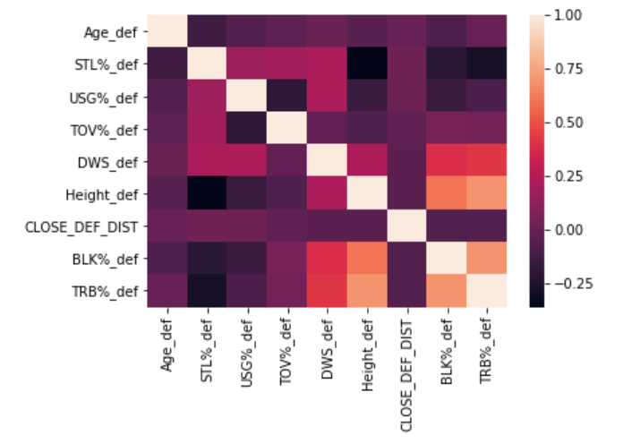
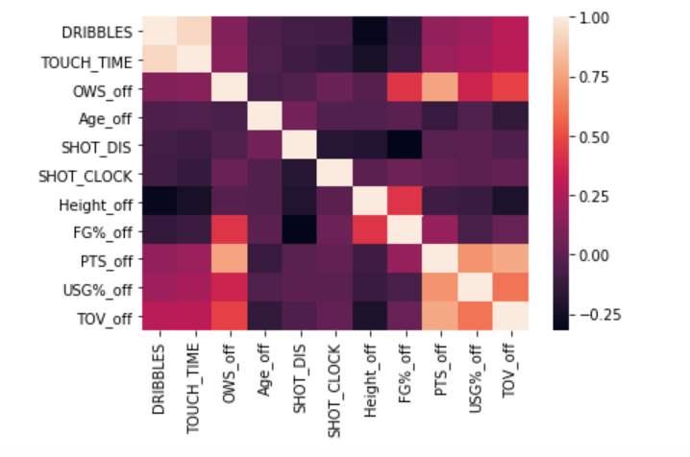
4.3 Logistic Regression
Notes:
If we take a look at the heatmap of correlation matrix, we might find that some variables are highly correlated to each other.

Slide 31
4.3 Logistic Regression
Player’s Variables:
Age
Height
Offense Win Share
Usage%
Turnover%
Field Goal%
Offense Box Plus/Minus
Touching Time
Dribbles
Defender’s Variables:
Age
Height
Defence Win Share
Usage%
Turnover%
Total Rebound%
Stealing%
Defence Box Plus/Minus
Blocking%
Distance to Player
Status:
Home/Away
Period (1-4)
Shot Clock
Shot Distance
Notes:
So in the second logistic regression, we delete those variables that is

Slide 32
4.3 Logistic Regression
Player’s Variables:
Age: 0.0069
Field Goal%: 1.2461
Offense Box Plus/Minus:
0.0283
Dribbles: -0.0218
Defender’s Variables:
Height: -0.0026
Blocking%: -0.0685
Distance to Player: 0.3998
Status:
Shot Clock:
0.0156
Shot Distance:
-0.2140
Notes:
These are the variables we choose to run data analysis. We try to select as many variables as possible in the first run to not miss any relevant factor. But we also ignore some variables that we perceived to be unimportant, for example, we do not consider whether the defender is a good shooter or not, but we focus on the defensive data like stealing, rebound and blocking.

Slide 33
4.3 Logistic Regression
Player Data
OBPM: 0.6
Dribble: 2
FG%: 45.3%
28 Years Old
Defender Data
2.01 m
Avg Block/Game = 1.76
Shooting Status
Time Left: 11s
44.1% chance of scoring.
1.23m
4.14m
Notes:
For a average person make a average shot -- which means we use the means of all variables to predict the probability of making a shot, is 44.1% which is close to the overall shooting average

Slide 34
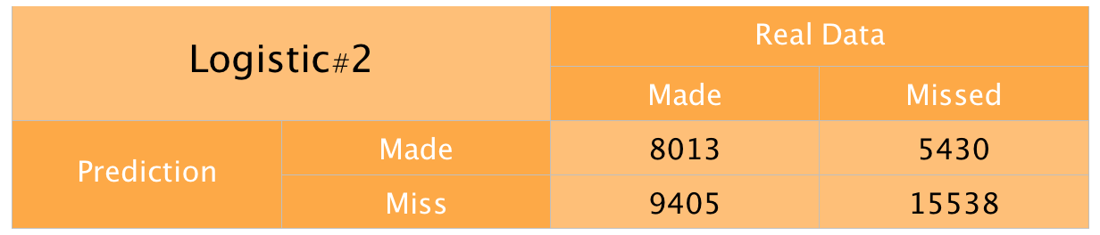
4.3 Logistics Regression
Logistic#2
Accuracy: 0.6136
Precision: 0.5965
Recall: 0.4592
F1-score: 0.5189
Logistic#1
Accuracy: 0.6135
Precision: 0.5962
Recall: 0.4591
F1-score: 0.5188
Notes:
confusion matrix:
[[15556 5412]
[ 9419 7999]]
______________________________________________
Model: Logistic Regression
Accuracy: 0.6136351794925233
Precision: 0.5964506748191782
Recall: 0.45923757032954415
F1-score: 0.5189269843329333
_________________________________________
From the confusion matrix, unfortunately this operation doesn’t help us to improve the accuracy

Slide 35
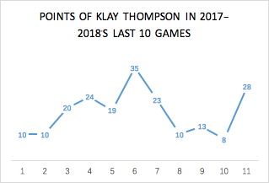
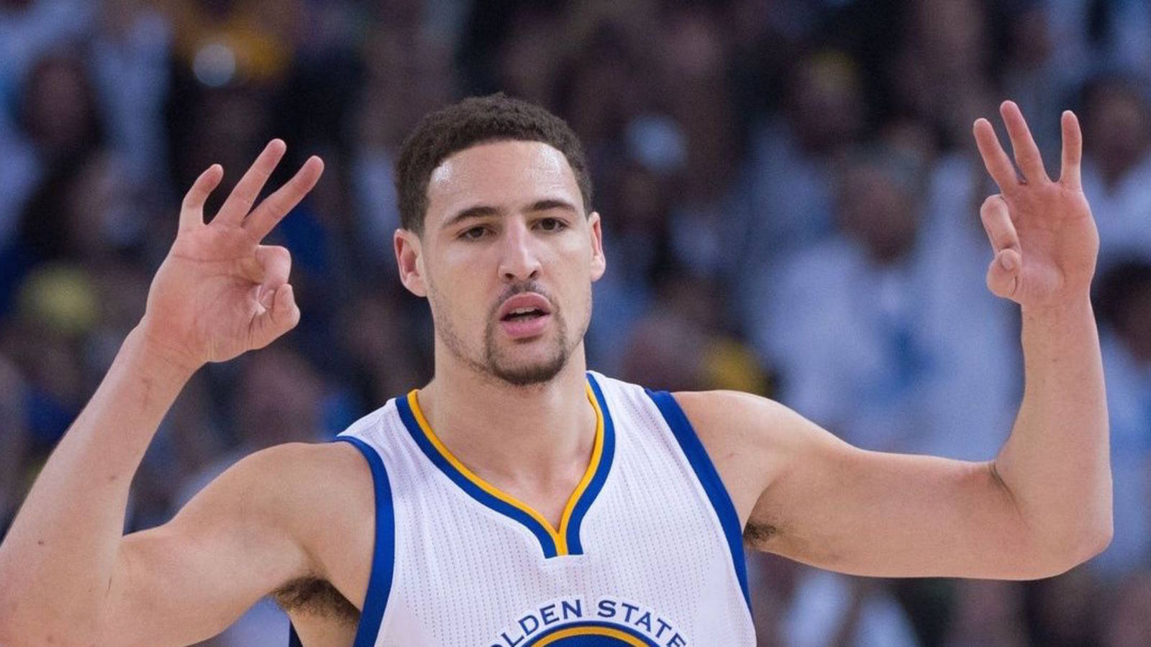
4.4 Evaluations
What did we miss?
Using seasonal data to predict player’s one game condition.
Possible Mitigation:
Real Time Prediction
Season
Avg:20
Notes:
Our first challenge comes from limitations on the data we have. We don’t know where the rest of the team when a player is making one shot. Basketball is never a one-on-one game, so your overall team strategy, team morale, team cohesiveness are all important elements that we cannot measure here.
Seasonal data can not represent the condition for player in one specific game, player’s shooting percentage might vary a lot

Slide 36

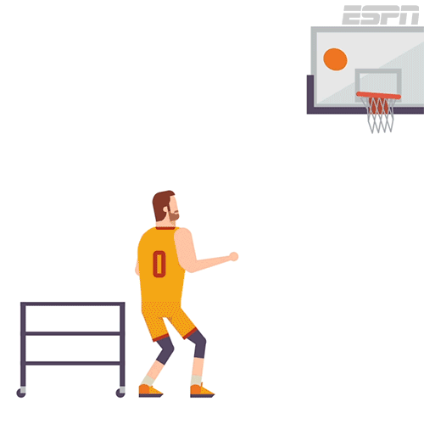
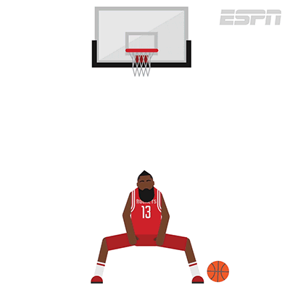
4.4 Evaluations
What did we miss?
Ignore the team-level effect
Something can’t be reflected by data
Notes:
Our second challenge comes from limitations on the data we have. We don’t know where the rest of the team when a player is making one shot. Basketball is never a one-on-one game, so your overall team strategy, team morale, team cohesiveness are all important elements that we cannot measure here.

Slide 37
5. Recommendations, Challenges and Mitigations

Slide 38


5.1 Recommendations and Challenges
Focus on developing a more cohesive strategy than improving individual skills.
Build team morale to ensure the players are at their maximum performance.
Stakeholders may not see the benefits and emphasize tradeoffs.
See next slide.
Notes:
They should…

Slide 39

5.2 Challenges & Mitigations
Notes:
Our first challenge comes from limitations on the data we have. To implement the strategies, the stakeholders need to take into account that the game is never 1-1, but it is about team effort.

Slide 40
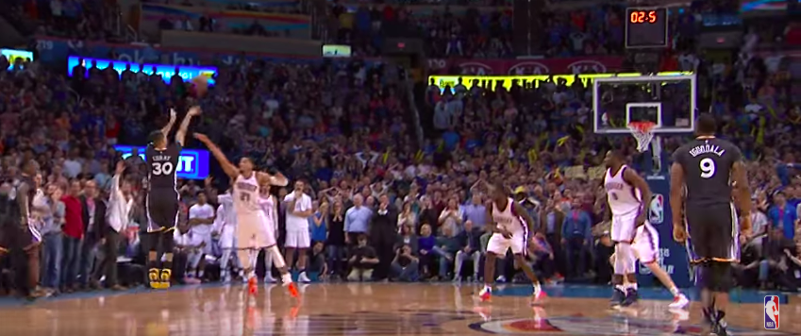
5.2 Challenges & Mitigations
0.12665207 is the chance of Curry scoring.
Notes:
#player: stephen curry, FG = 0.504（当库里投篮时，根据以往数据，他大概有50%的概率会进）, AGE = 27, OBPM = 12.4（curry在场时进攻分数比对手高出12.4分
#defender: André Roberson, HEIGHT = 201, blk% = 2(场均两个盖帽),
# SHOT_DISTANCE= 11.28M , SHOT CLOCK = 0.6s（本进攻回合结束时还剩下0.6秒，不是出手剩下的时间）
# Defender distance = 0.3（几乎碰到了 估计出来的）
# Dribbles = 3（投篮前运了三次球）
你可以说这个球实际上会受到更多的影响：比如球员心态，观众支持等这些没有被数据记录的东西，使最终的命中率应该更低。

Slide 41
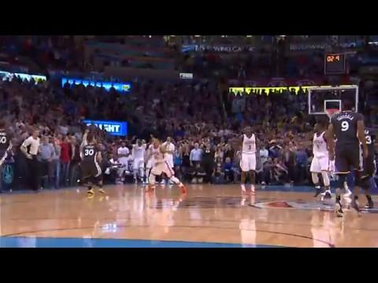
5.2 Challenges & Mitigations

Slide 42

THANKS!
We are now ready for your questions and feedback.

Slide 43
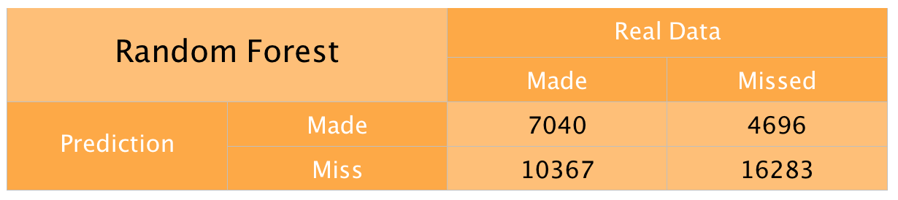
4.2 APPENDIX
Number of Trees: 100
Accuracy: 0.6076
Precision: 0.5999
Recall: 0.40443
F1-score: 0.4831

Slide 44
4.2 APPENDIX
Number of Trees: 200
Accuracy: 0.6076
Precision: 0.5999
Recall: 0.40443
F1-score: 0.4831
Notes:
confusion matrix:
[[16438 4541]
[10388 7019]]
______________________________________________
Model: Random Forest n = 200
Accuracy: 0.6110821653727921
Precision: 0.6071799307958478
Recall: 0.40322858620095364
F1-score: 0.4846204301446474

Slide 45
4.2 APPENDIX
Number of Trees: 300
Accuracy: 0.6199
Precision: 0.6097
Recall: 0.4010
F1-score: 0.4839
Notes:
confusion matrix: [[16511 4468] [10426 6981]] ______________________________________________ Model: Random Forest Accuracy: 0.611993956129839 Precision: 0.6097475762075291 Recall: 0.4010455563853622 F1-score: 0.48385084557804264

Slide 46
4.2 APPENDIX
Number of Trees: 400
Accuracy: 0.6199
Precision: 0.6097
Recall: 0.4010
F1-score: 0.4839
Notes:
confusion matrix: [[16512 4467] [10437 6970]] ______________________________________________ Model: Random Forest Accuracy: 0.6117334444849685 Precision: 0.6094255486578648 Recall: 0.40041362670190156 F1-score: 0.48328941894328104

Slide 47
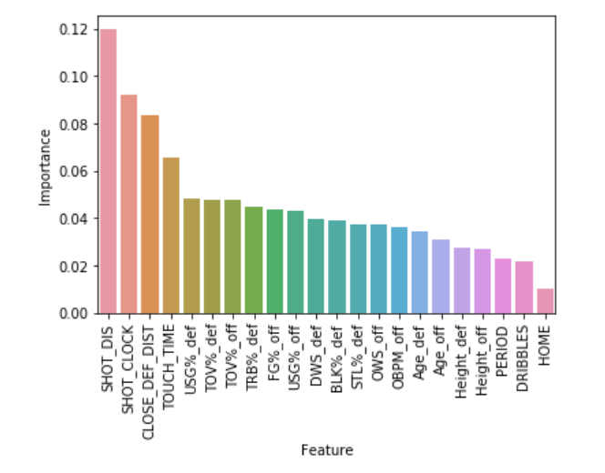
4.2 Appendix Importance
STATUS:
SHOT_DIS
SHOT_CLOCK
DEF:
CLOSE_DEF_DIST
OFF:
TOUCH_TIME
Notes:
A quick glance at the importance of each feature. The classification of results mainly depend on the shot status rather than the player’s

Slide 48
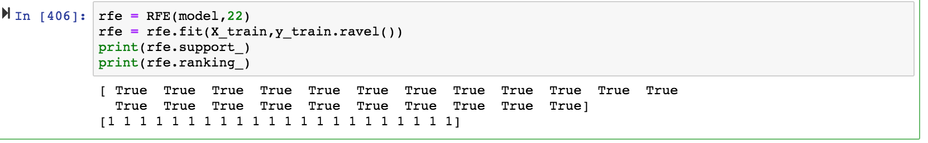
4.2 APPENDIX
Notes:
confusion matrix: [[16512 4467] [10437 6970]] ______________________________________________ Model: Random Forest Accuracy: 0.6117334444849685 Precision: 0.6094255486578648 Recall: 0.40041362670190156 F1-score: 0.48328941894328104

